Slide 1

Chicago Crime Analysis
Miguel Fernandez

Slide 2

OUtline
Introduction
Data Analysis
Recommendations
Source: unsplash.com, Lance Anderson

Slide 3

Introduction
Data from January 1, 2018 – December 30, 2018
15,000 reports
Type of Crime
Location of Crime
Was an Arrest Made?
Source: unsplash.com, Bill Oxford

Slide 4
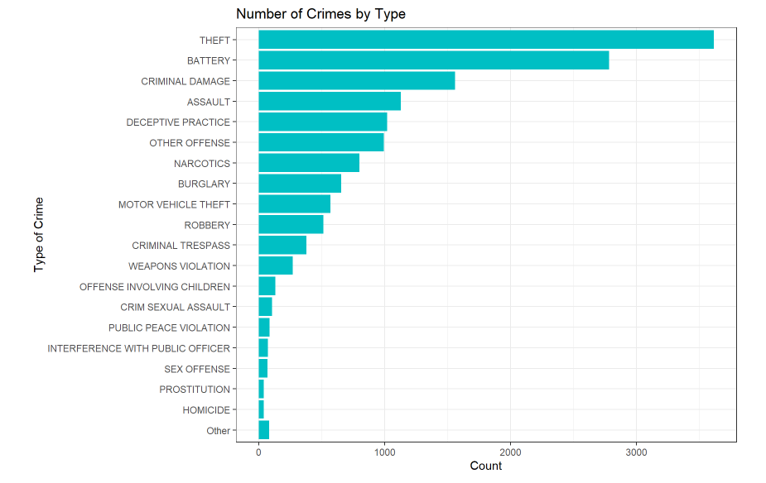
What is the most common type of crime?
25 % of crimes are theft
The top 5 crimes account for 66 % of all crimes
41 homicides in 2018

Slide 5
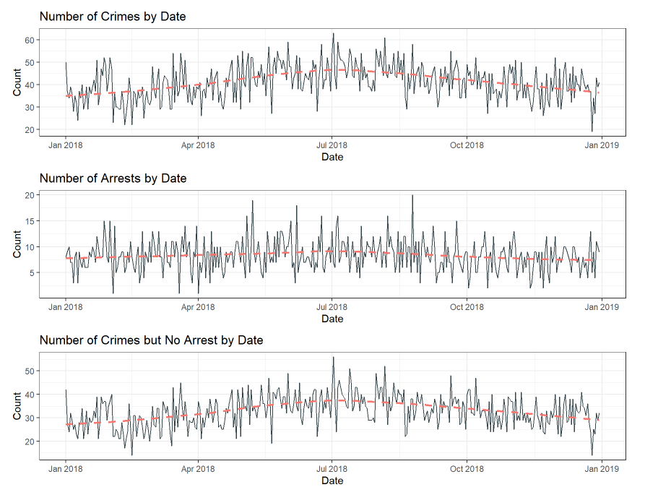
Crimes & arrests throughout the year
Crimes peak during summer months
Daily arrests remain constant
High number of crimes on around New Year’s and 4th of July

Slide 6
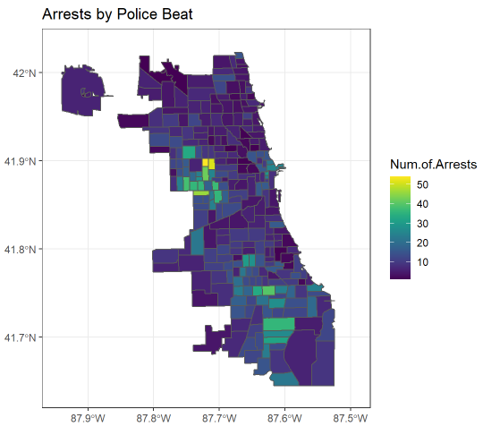
Thinking spatially
There is a distinct cluster of arrests to the west of the city.
What is happening there that is causing the high number of arrests?

Slide 7

Recommended Variables for predictive model
Location Description
Type of Crime
Spatial component, e.g., Beat, Ward, or District
Will need multiple models with combination of various predictors
Source: unsplash.com, Scott Graham

